Slide 1
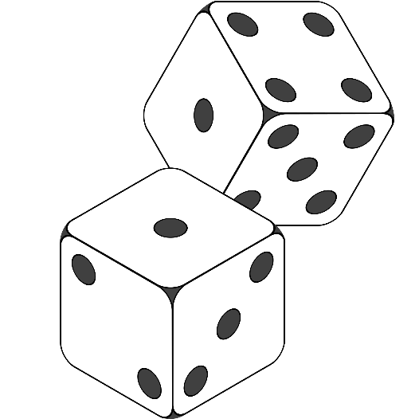
Team Chili
Console Project Game
Monopoly

Slide 2
Team Chili
Team members:
lnxslackware, kskondov, emil_t, vasil.subeff, plomba97, a.sideriss, user1, v.todorov

Slide 3
Team Chili
Monopoly is a board game. Players move around the gameboard buying or trading properties, developing their properties with houses and hotels, and collecting rent from their opponents, with the goal being to drive them all into bankruptsy leaving one monopolist in control of the entire economy.

Slide 4
Team Chili
Main elements:
Players, Spaces, Dices, Cards
Properties, Bank, Center Console, Auto Full Screen Console,

